Slide 1


A
Project Report On
CLASSIC WATCH ONLINE SELLING
^{6th} Semester
IN B.C.A
SUBMITTED BY
RAHUL SHARMA
(17BCA096)
&
ANANT PIPARIYA
(17BCA079)
SUBMITTED TO
DEPARTMENT OF COMPUTER SCIENCE M & N VIRANI SCIENCE COLLEGE, RAJKOT
INTERNAL GUIDE:
Jignesh Hirapara
Ripal Ranpara

Slide 2
(1) Introduction
Introduction
Classic watch is an online selling website in which buyer could buy a wrist watch online
This site could help customers to buy a new watch easily.
User can buy a watch by category like Analog watch, Digital watch, Hybrid watch, Touch screen watch.
Also user can buy a watch by Watch Style Causal watch, Dress watch, Fashion watch, luxury watch.
User can buy a watch based on movement like Quartz, Mechanical Automatic and Solar.
Online watch buying website is very easy to access and users could save the time and he/she can access website everywhere.
User is no need to visit a watch shop/store. Sometime watch shop is close but users can shop 24x7 using our website. The online system is available to use anytime
They just need internet and smart device like Smartphone and laptop etc.
User is no need to visit a watch shop/store. Sometime watch shop is close but users can shop 24x7using our website. The online system is available to use anytime.
They just need internet and smart device like Smartphone and laptop etc.

Slide 3
(2) Modules
MODULES OF CLASSIC WATCH
Admin Profile : admin can see all the products, add a new product, change the price of product and also delete old products. Admin give discount on product.
Customer profile : customer can see various products ,buy a product , add product into cart ,delete from cart and they can have many types of payment gateway.
Log in / create new account : user can log in in our website or they can create a new account.
Payment Gatway: user can do three way to payment in our website like
Cash On Delivery, Credit Card and Debit Card.

Slide 4
(3) Project Planning & Analysis
PROJECT PLANNING
Project Title : Classic Watch Online
Selling
Starting Date : 05-07-2019
Ending Date : 20-03-2020
Project Scheduling
The toughest part of software development can be said to Planning and scheduling. This project has many features like add, update, delete a watch.
Scheduling of the project implies the adequate resources are available or not. Each small task of the project is scheduled by time, person and many other factors. Gantt chart is a type of bar chart. Here, the Gantt chart for various activities to develop a project is described.

Slide 5
Software requirement specifications (SRS)
Functional Requirements:
System Requirements (Hardware, Software)
The requirements for development and implementation of this application are categorized into following categories.
Hardware Requirements
Client side
category | Requirement
Device | Android supported
Developer side
Category | Requirement
RAM | 256 MB
Space on disk | Minimum 256MB

Slide 6
User side
Category | Requirement
Chrome,internetexplore | Our project support any chrome version and internetexplore
Developer side
Category | Requirement
OS | Window,Linux
Techonology use | Php,Html,Css

Slide 7
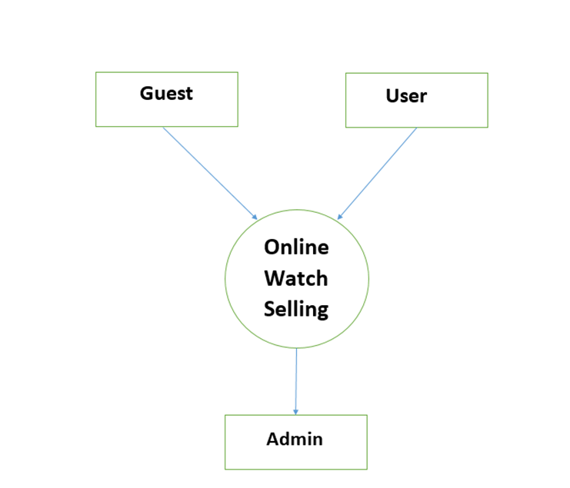
(4) Diagrams
DFD’s Diagram
ZERO Level Diagram:-

Slide 8
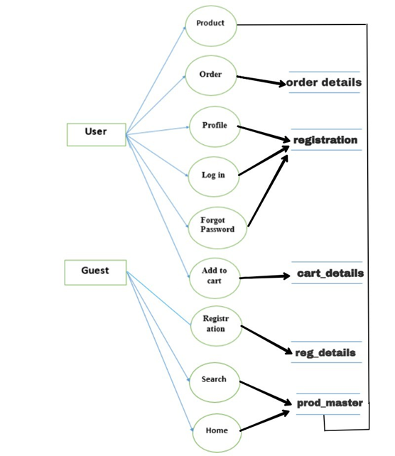
First Level Diagram

Slide 9
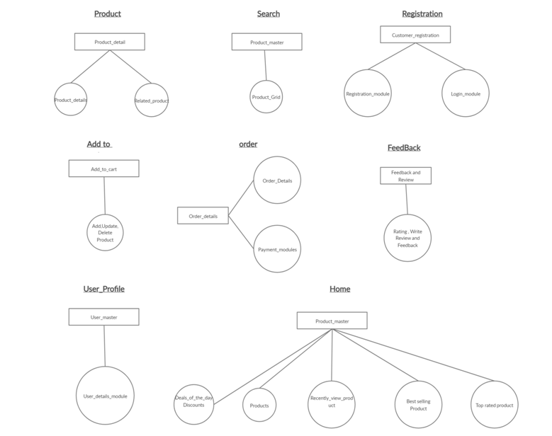
Second Level Diagram:-

Slide 10
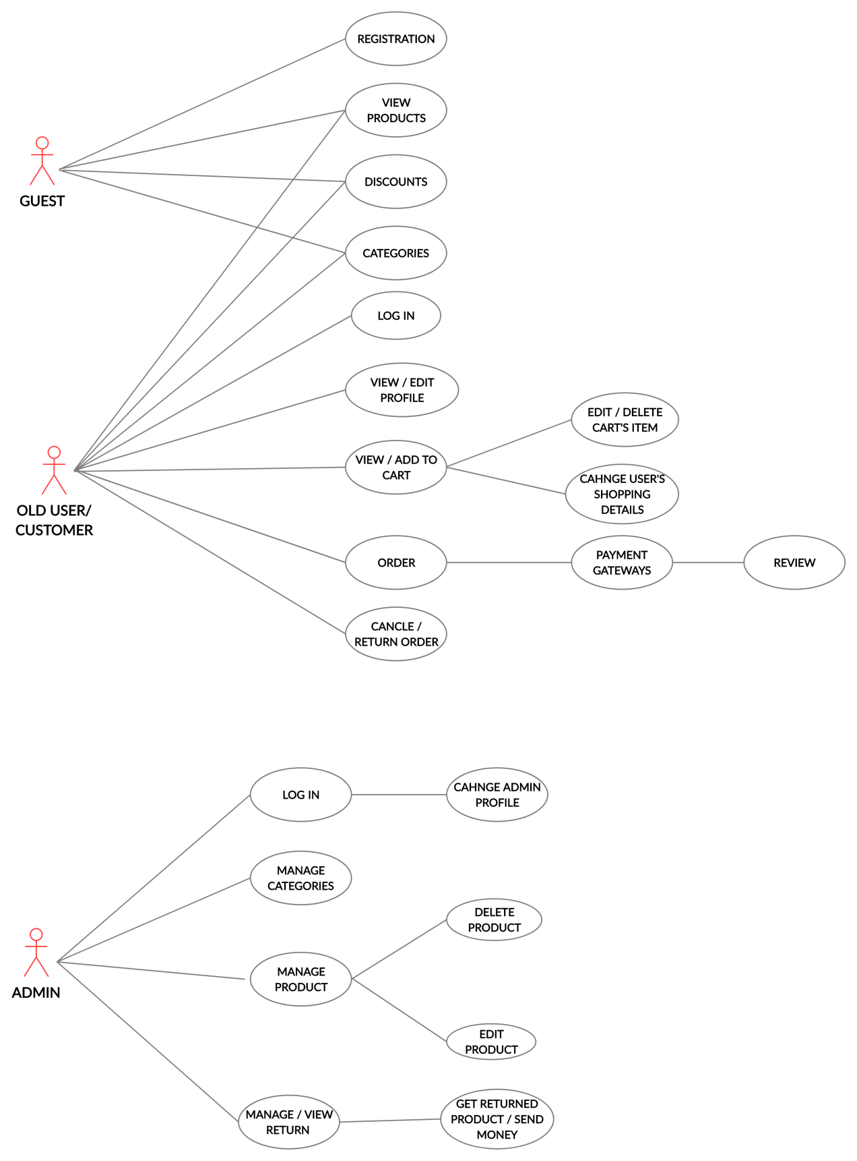
Use Case Diagram :-

Slide 11
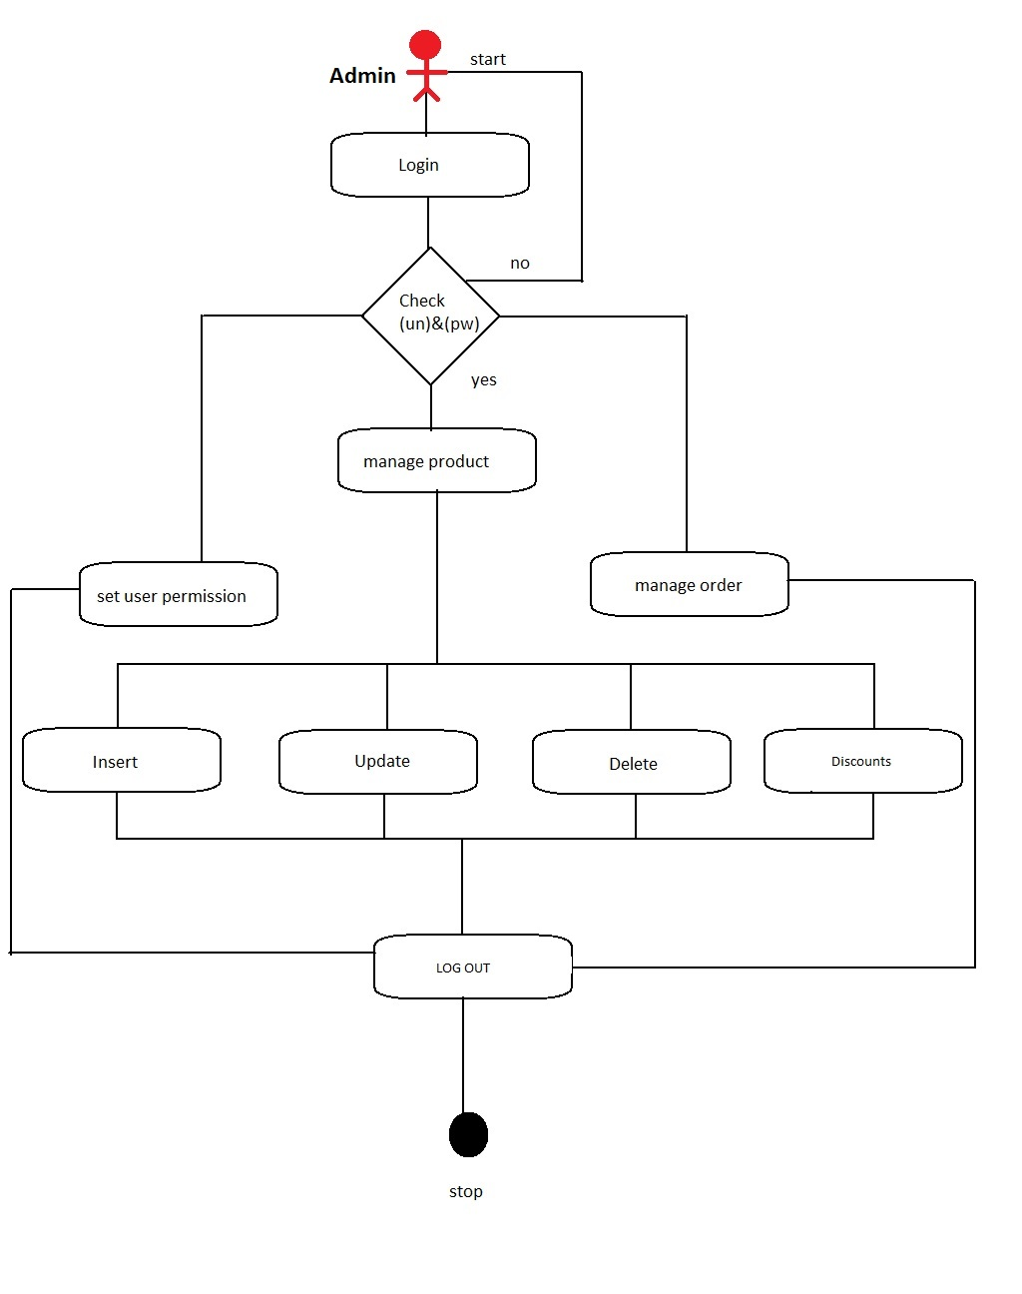
Activity Diagram
Admin Activity:-

Slide 12
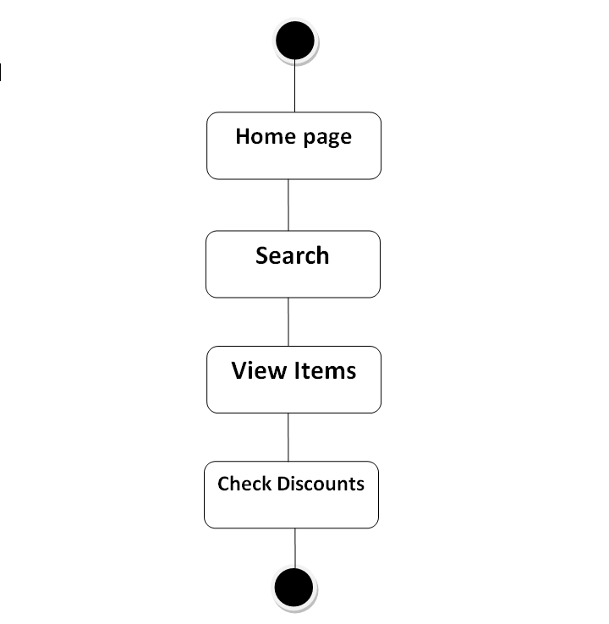
Guest Activity :-

Slide 13
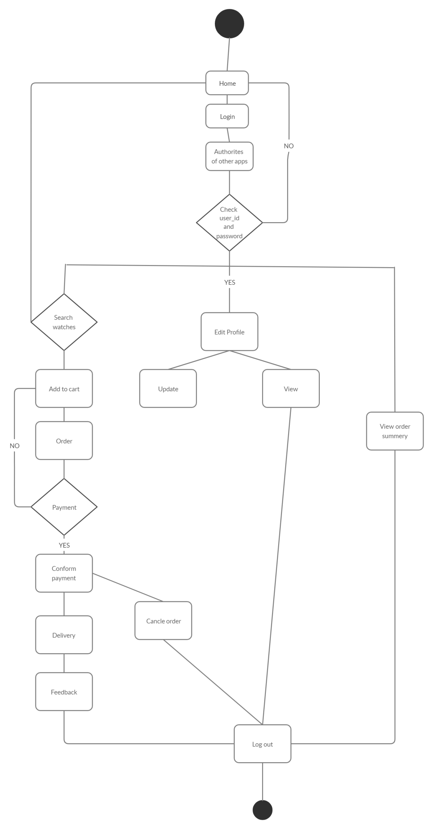
Guest Log In :-

Slide 14
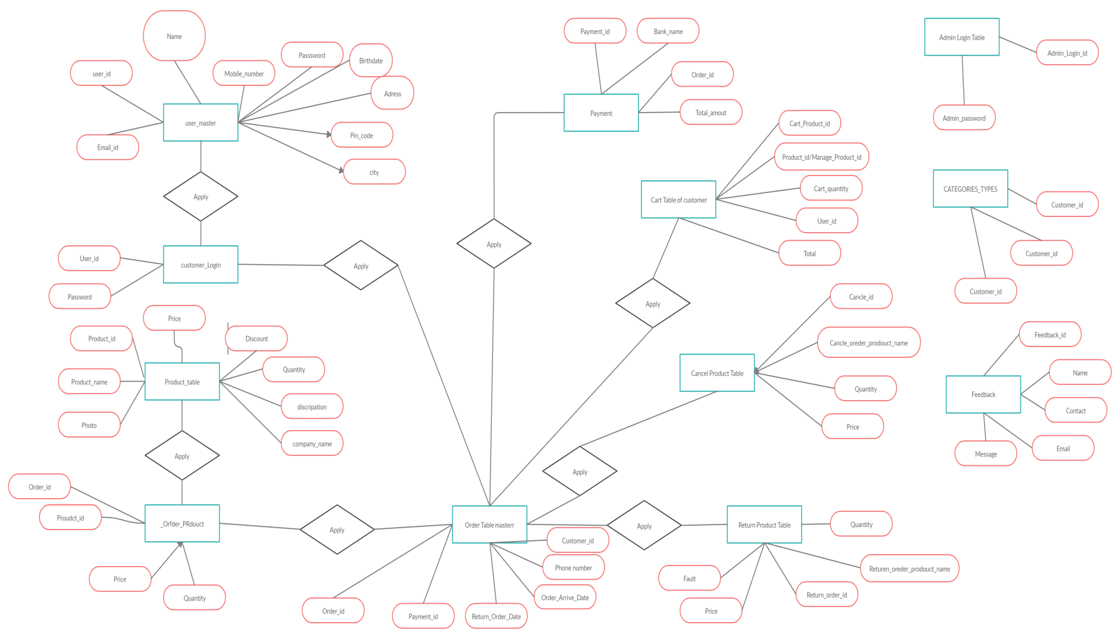
E R Diagram

Slide 15
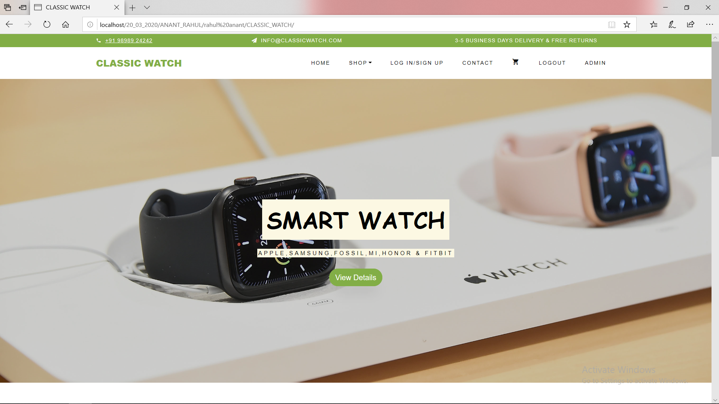
System Design
HomePage
Introduction:-
Systems design is the process of defining the architecture, components, modules, interfaces, and data for a system to satisfy specified requirements.
Logical Design:-
The logical design of a system pertains to an abstract representation of the data flows, inputs and outputs of the system.
In the context of systems design are included. Logical design includes Zero level ,First level diagram and Use case Diagrams.

Slide 16
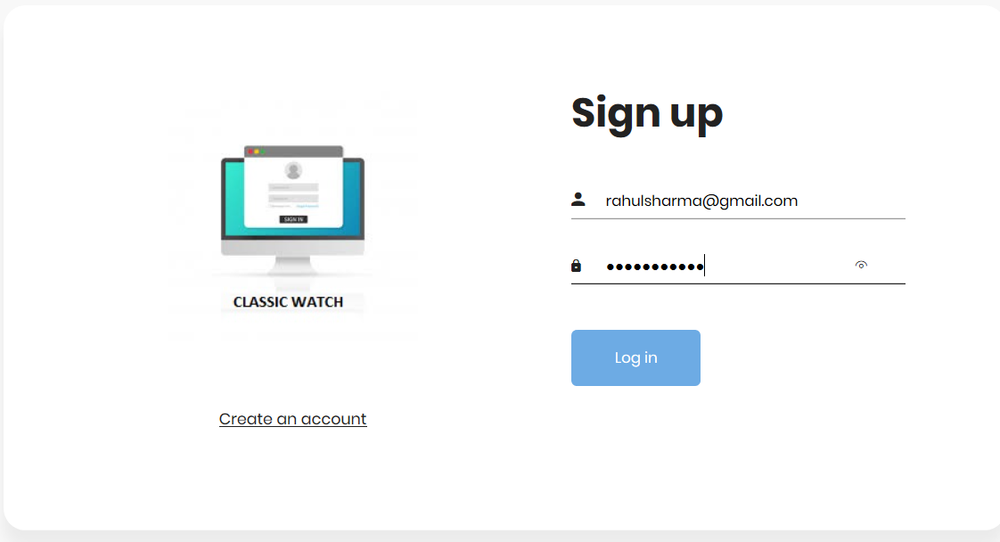
LOG IN PAGE:
Description :
There are many types of features available in our CLASSIC WATCH WEBSITE
User can see different types of watch categories like Smart Watch, Automatic Watch, Smart Band,Steel Belt Watch, Premium Watch, Leather Watch. To see any type of watch go to that category.
First of all you must login and then you will buy watch.
If you havenot account you click on create account link.

Slide 17
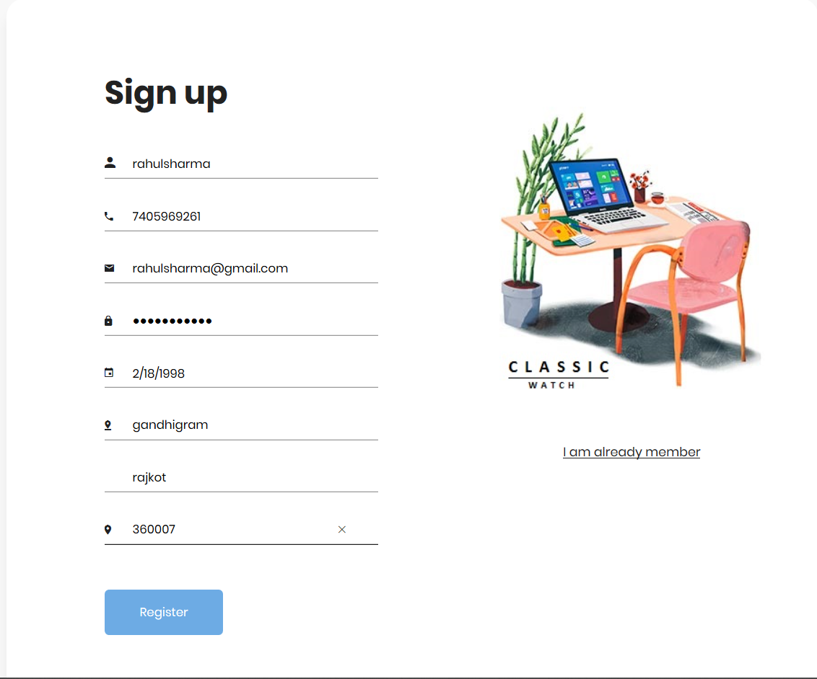
SIGN UP PAGE :
Description :
If you have a account than you first of all
create an account.
You must fill the that kind of details about
your self

Slide 18
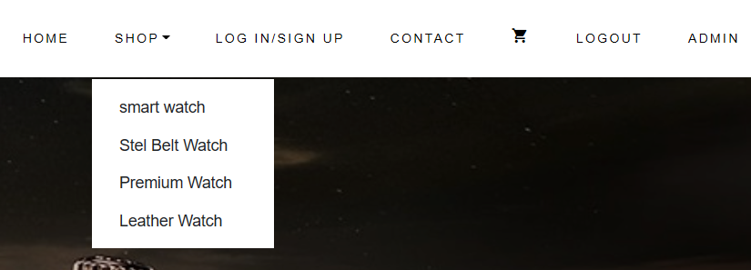
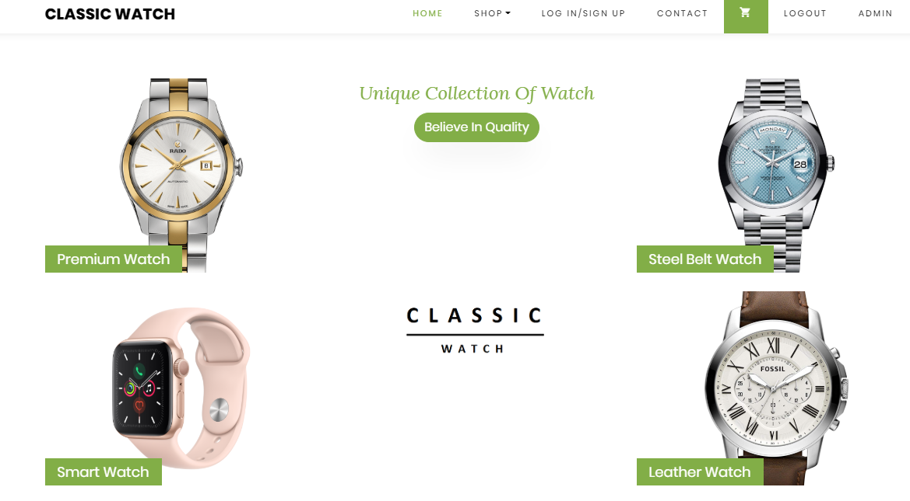
CATEGORY OF WATCH :
Description :
In our Website , you can see many types of categories in watch.

Slide 19
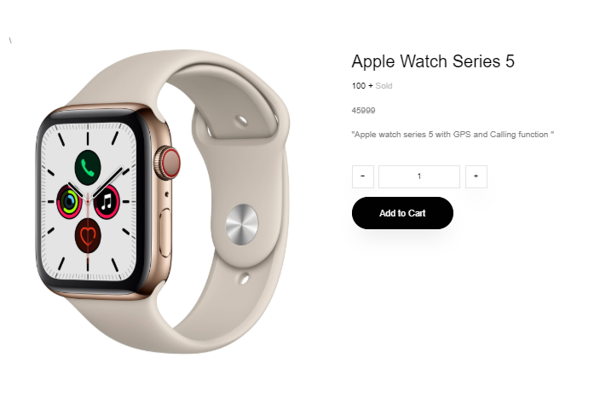
ADD TO CART:
Description :
It is use to add your product in cart.
You can one and more product you can select.

Slide 20
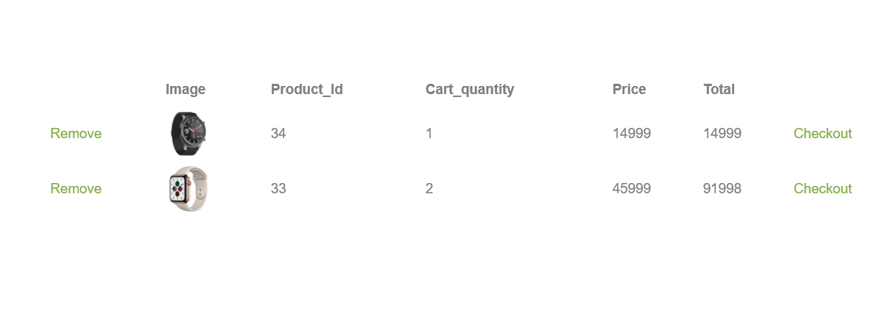
CART PAGE:
Description :
You can see your product in your cart which is you select.
If you donot like a product you can also remove with using remove link.
If you want to buy a product you can click on the checkout link.

Slide 21
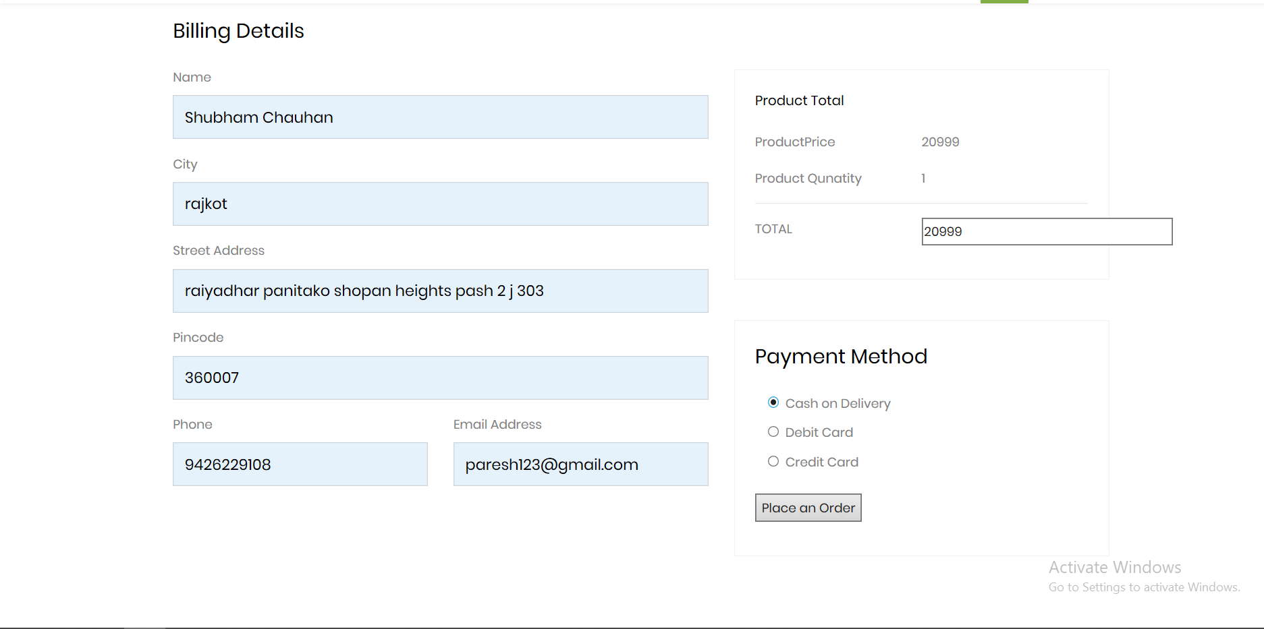
Payment gatway:
Cash On Delivery
Description :
If you want to buy a watch so you can fill the details and then click on place order button.
You must fill the details.
In this secution you can give money after product reach at home

Slide 22
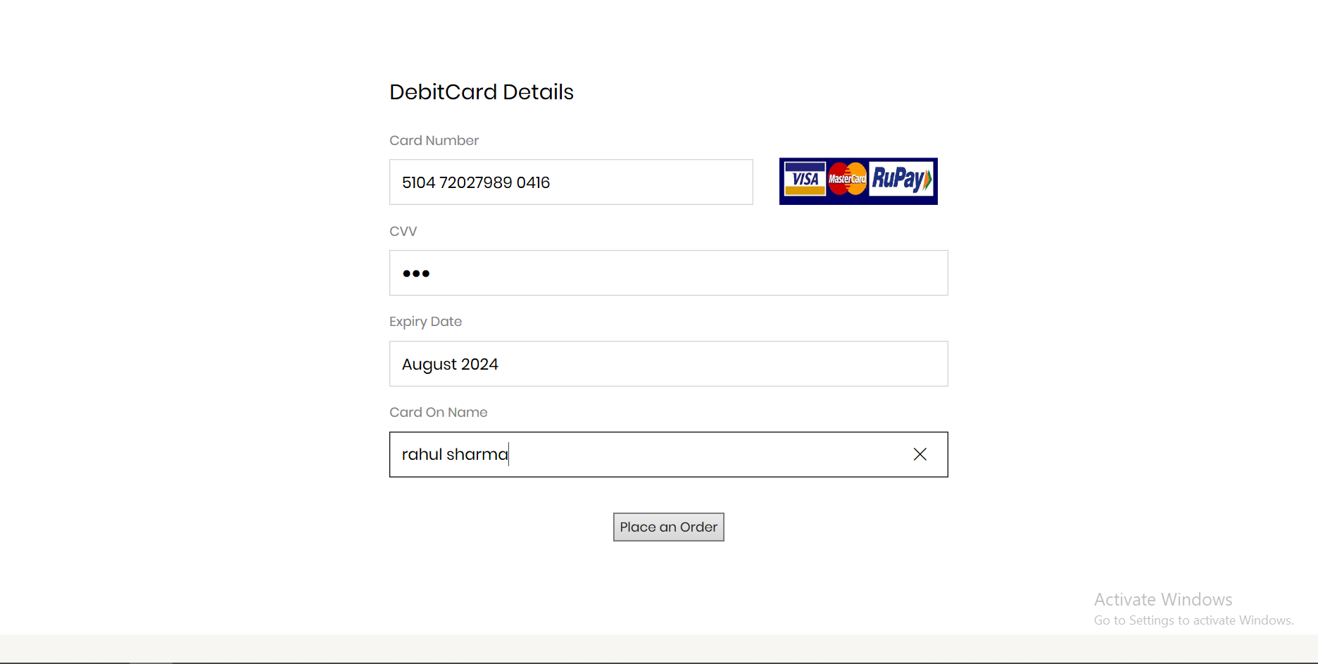
Debit Card
Description :
If you want to buy a watch so you can fill the details and then click on place order button.
You must fill the details.
In this secution you can give money thorugh debit card.

Slide 23
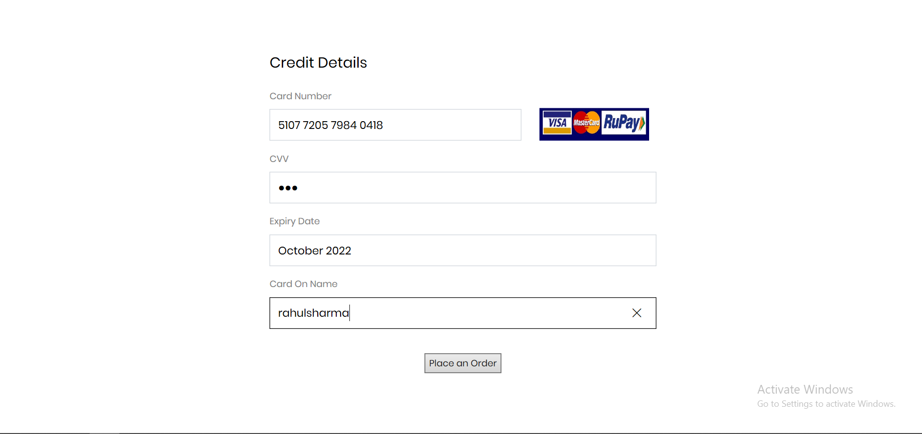
Credit Card
Description :
If you want to buy a watch so you can fill the details and then click on place order button.
You must fill the details.
In this secution you can give money thorugh credit card.

Slide 24
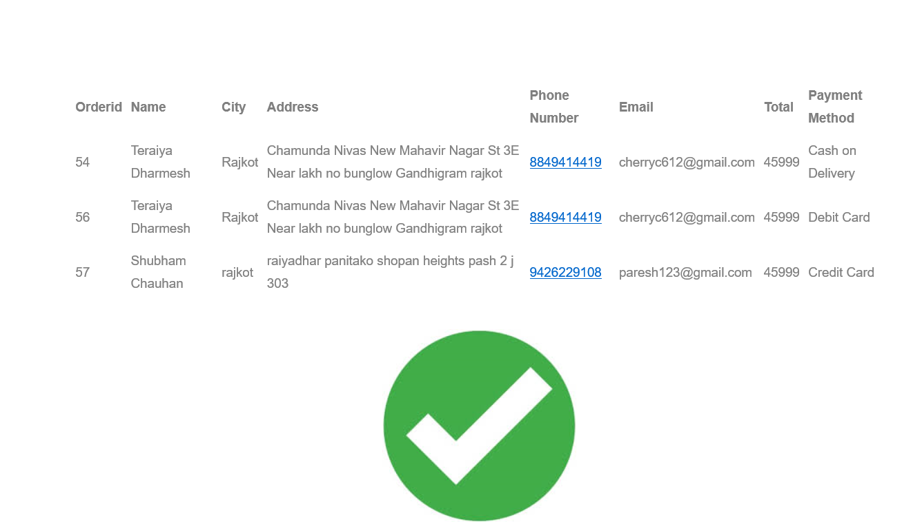
Order Summary:
Description :
If your order is successfully place then your order you check it .

Slide 25
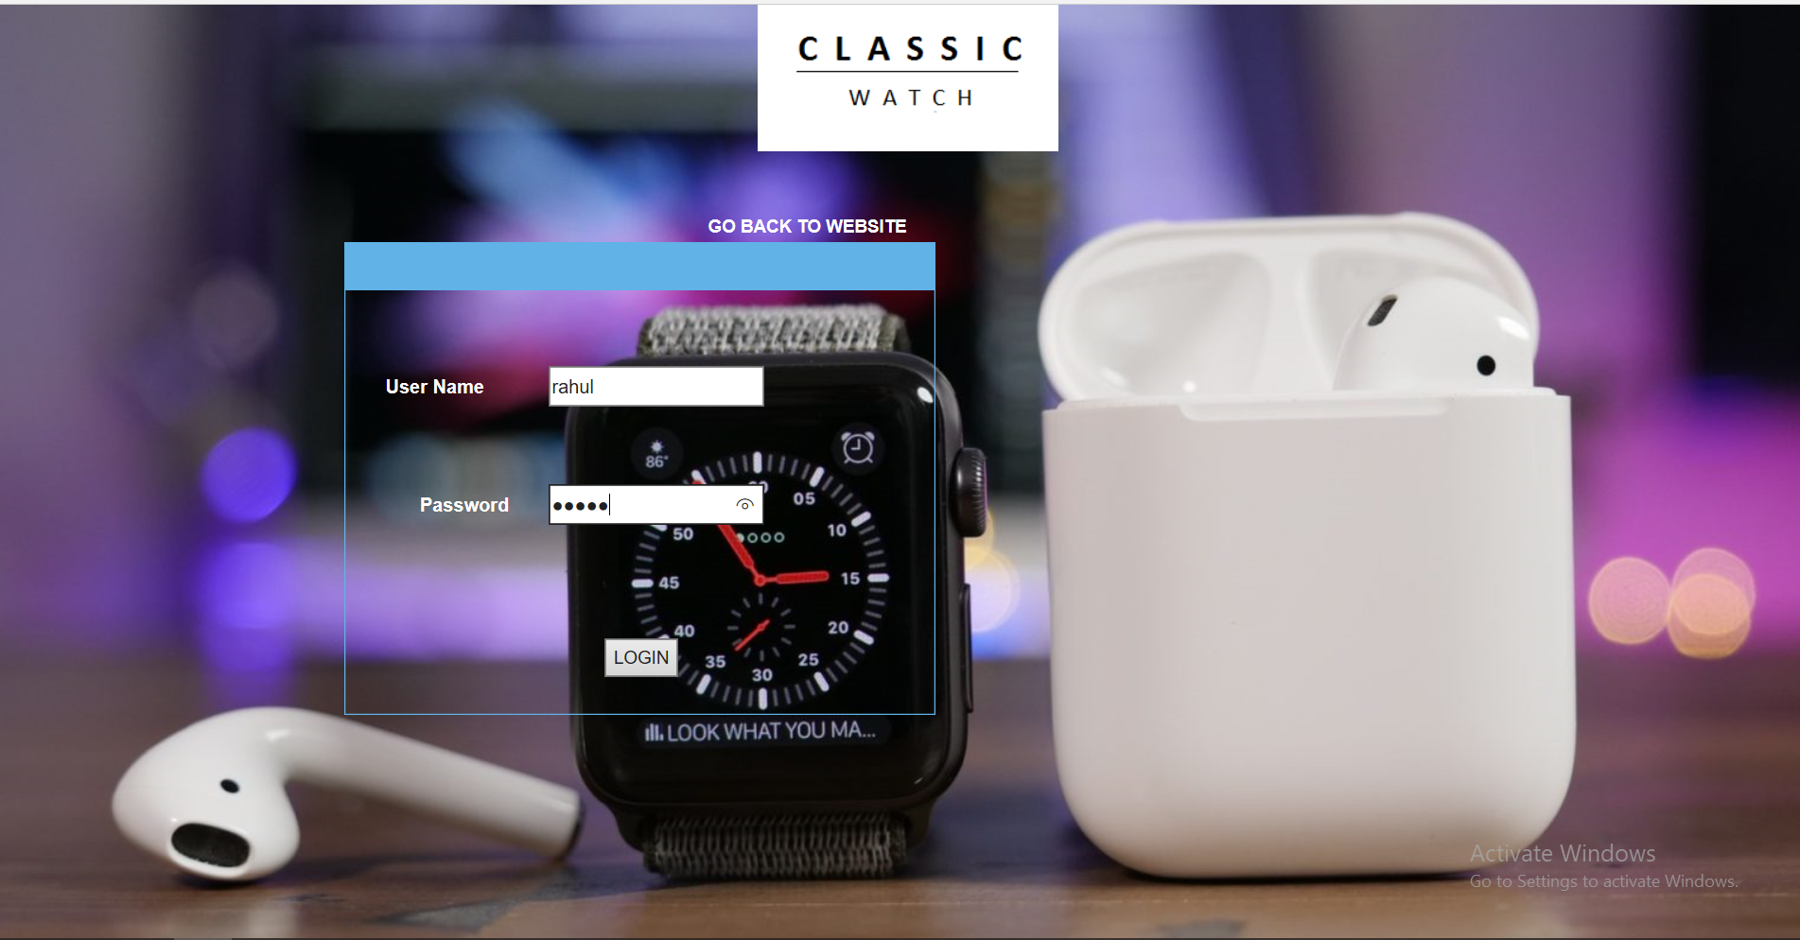
(7) Admin Panel
LOGIN PAGE :
Description :
Admin is login only.

Slide 26
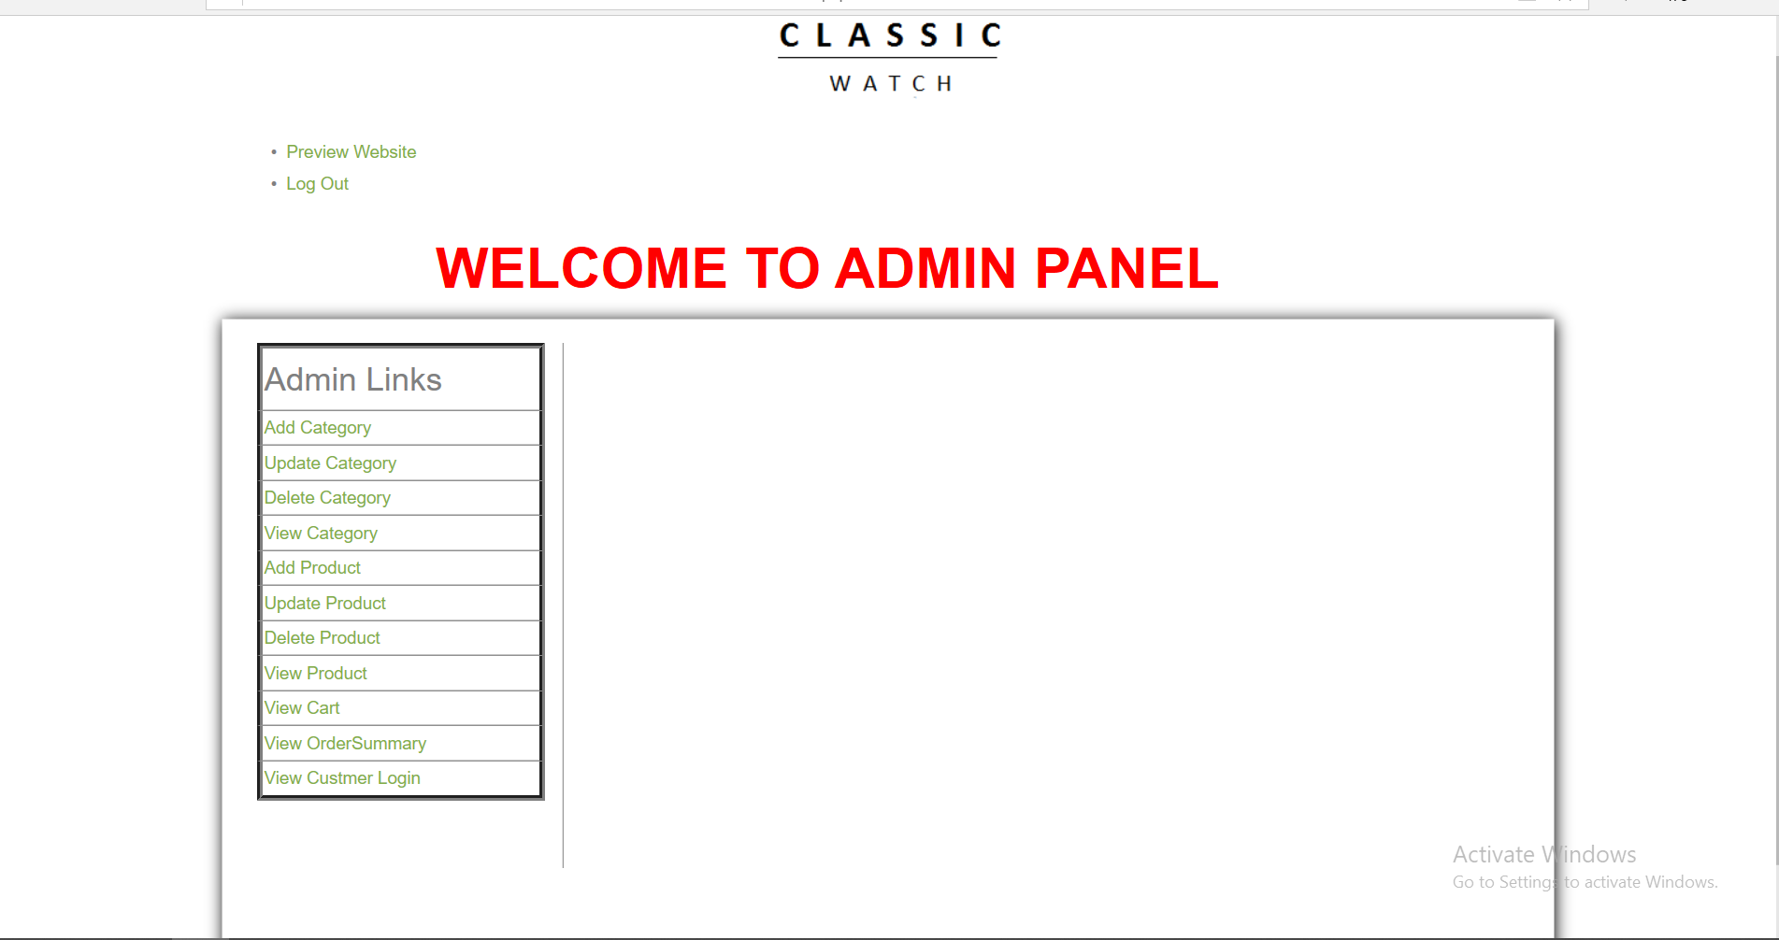
ADMIN PAGE
Description :
It is admin page admin can do add product and delete product, update product,
view product.
Admin can do add category,update and delete category,view category.
Admin can show login details of cutsmor.
Admin can also view product which you are put in cart.
Admin can also view the order of yours.

Slide 27
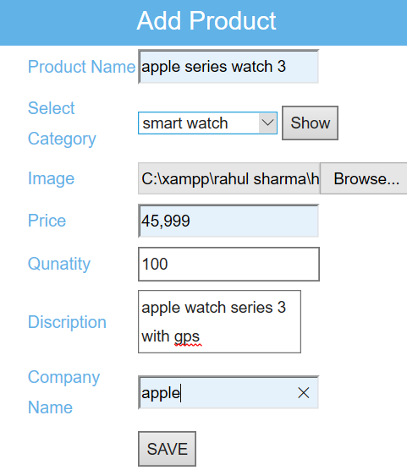
ADD PRODUCT
Description :
Admin is add product in this.

Slide 28
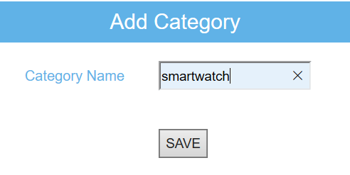
ADD CATEGORY
Description :
Admin can add category in this page .

Slide 29
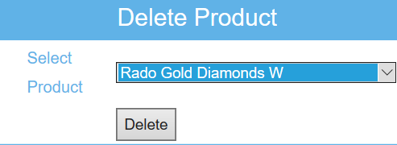
DELETE PRODUCT
Description :
You can select product and click on the delete product.
You can delete product.

Slide 30
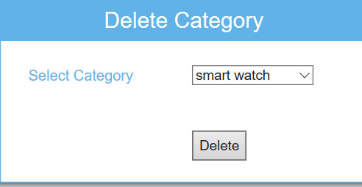
DELETE CATEGORY
Description :
You can select category and click on the delete catrgeory.
You can delete product.

Slide 31
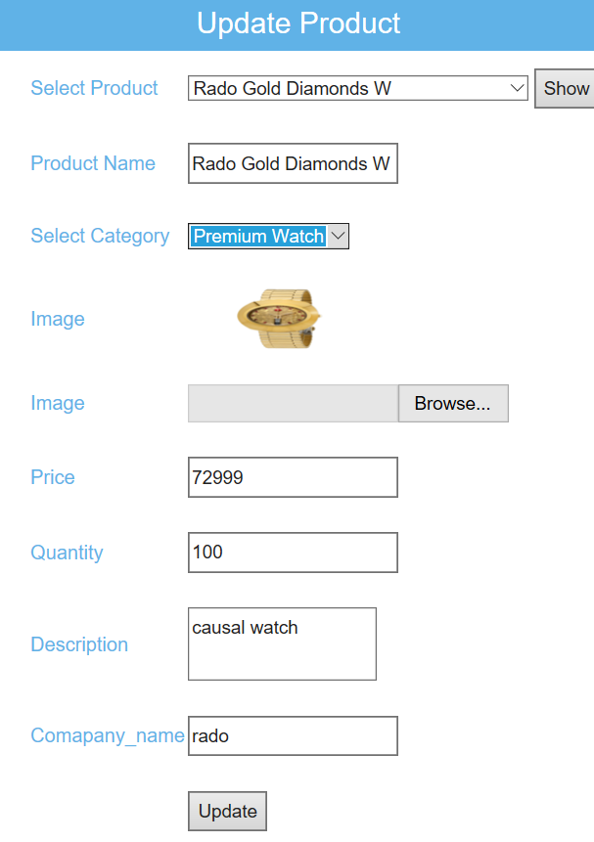
UPDATE PRODUCT
Description :
First of all you can select product and click on the show button.
So you can show all the details about the product.
If you want to update product So you can click on the update button.
You can update product.

Slide 32
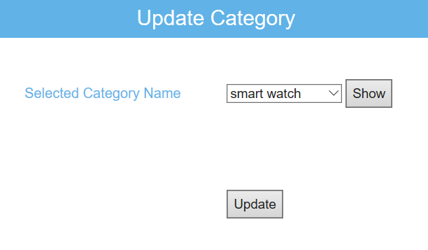
UPDATE CATEGORY
Description :
First of all you can select category and click on the show button.
So you can show all the details about the category.
If you want to update category so you can click on the update button.
You can update category.

Slide 33
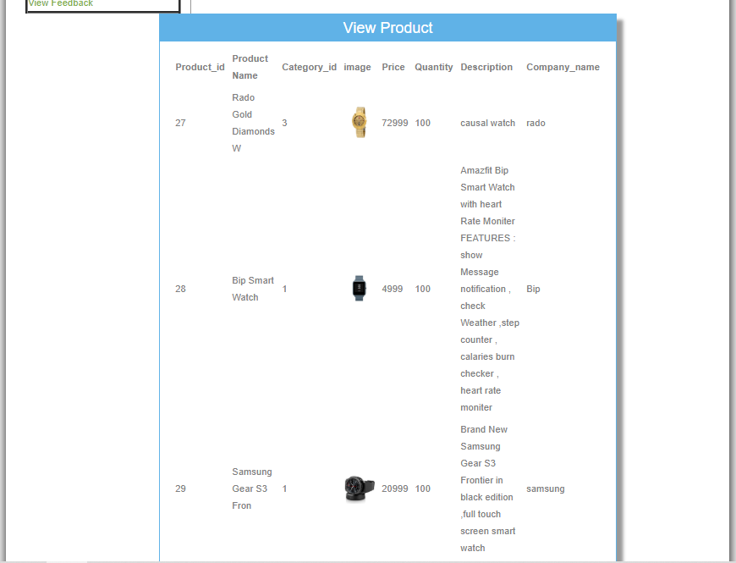
View Product
Description :
Admin can view the product which he can add.

Slide 34
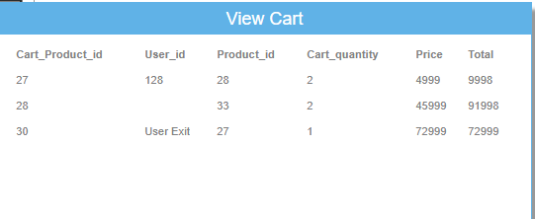
VIEW CART
Description :
You can show the product which coustmer are put in cart

Slide 35
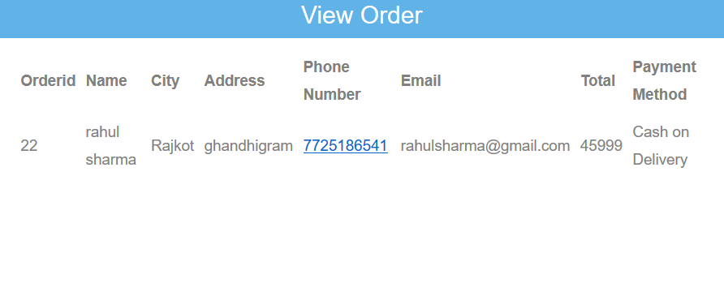
VIEW ORDER
Description :
You can show the order.

Slide 36
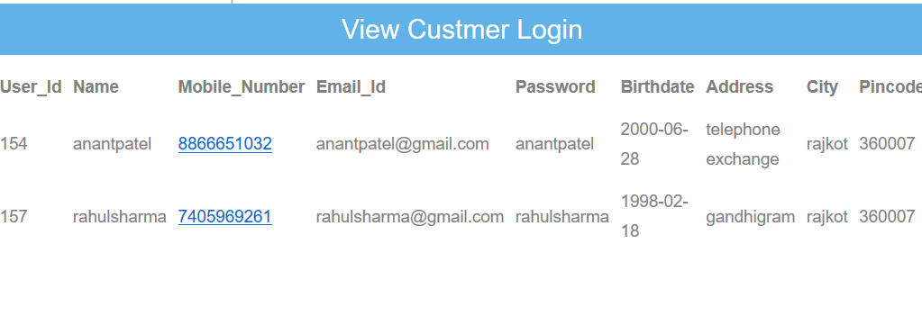
VIEW Cutsomer
Description :
You can show the details about customer.

Slide 37
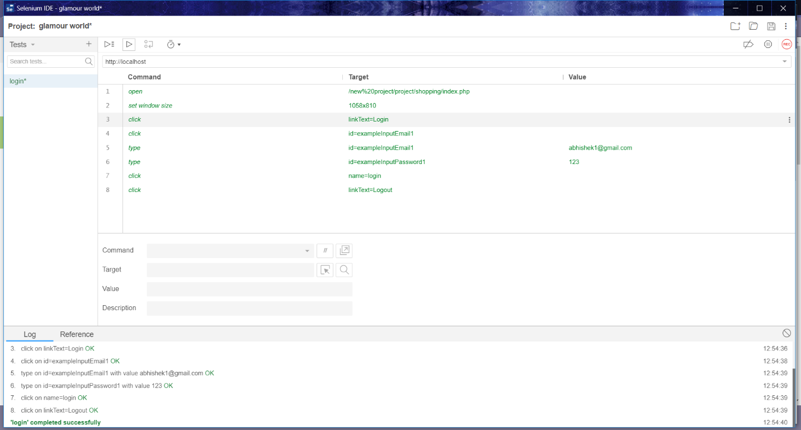
TESTING

Slide 38
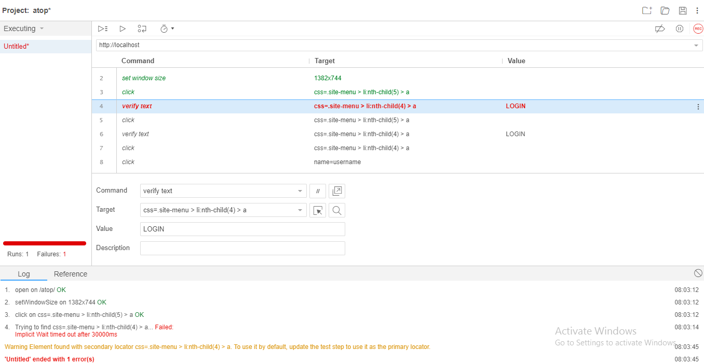

Slide 39
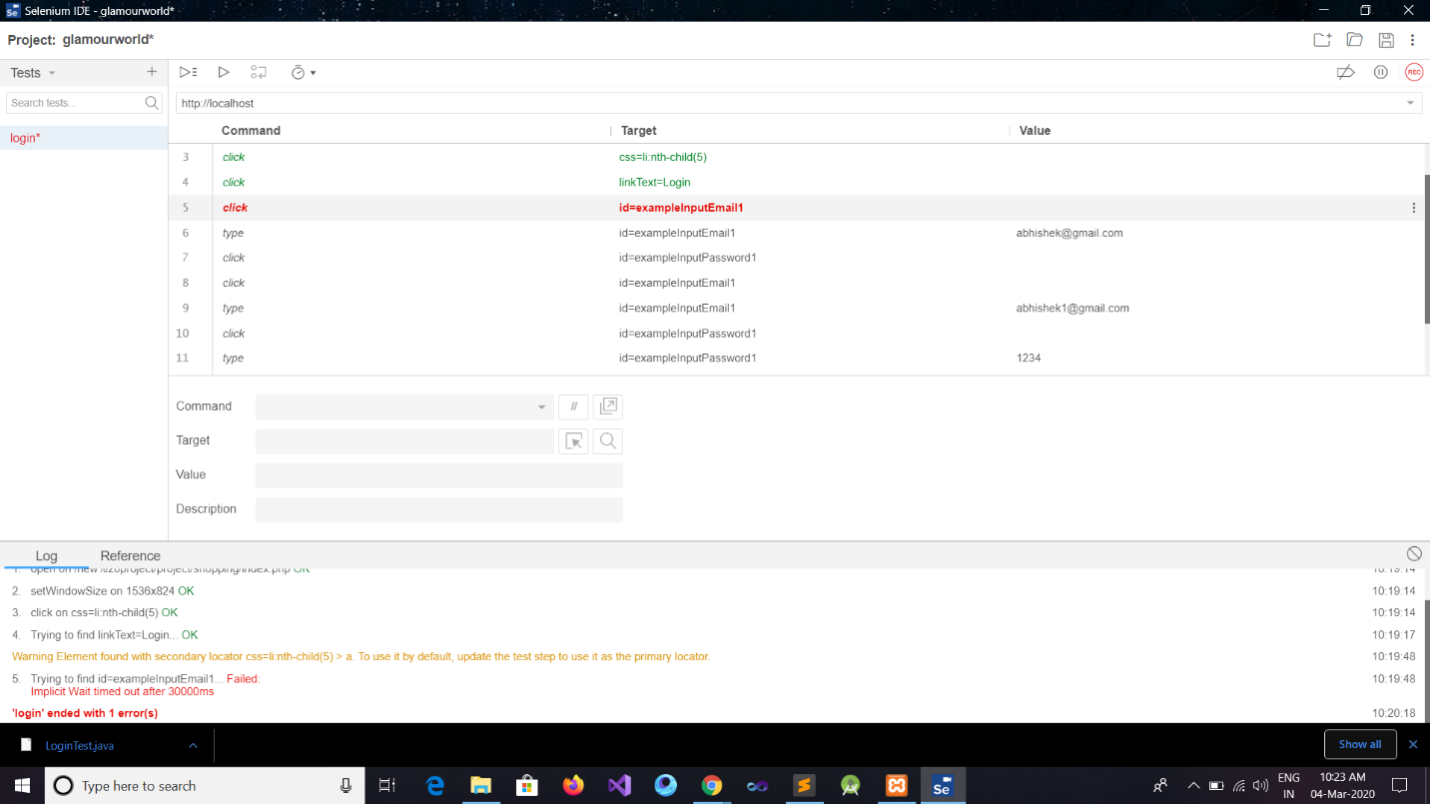

Slide 40
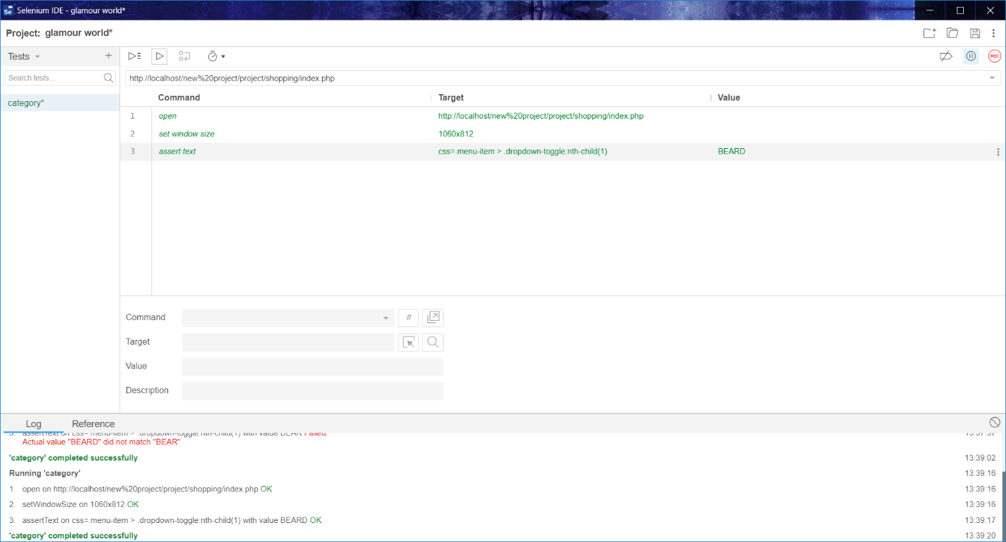

Slide 41
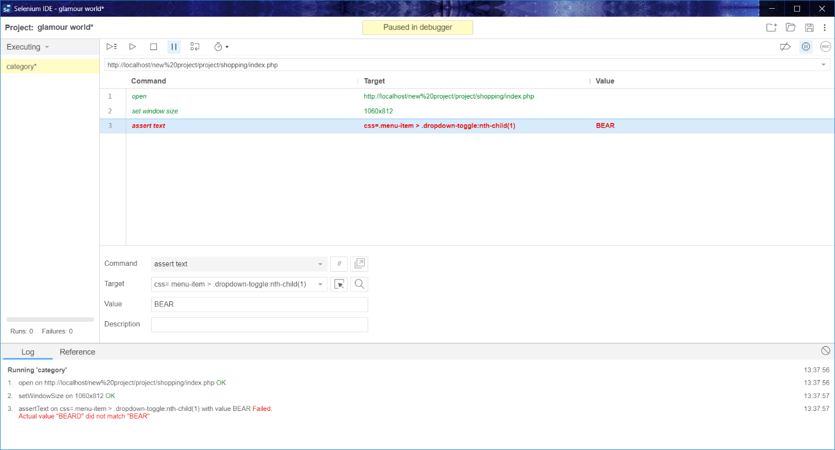

Slide 42
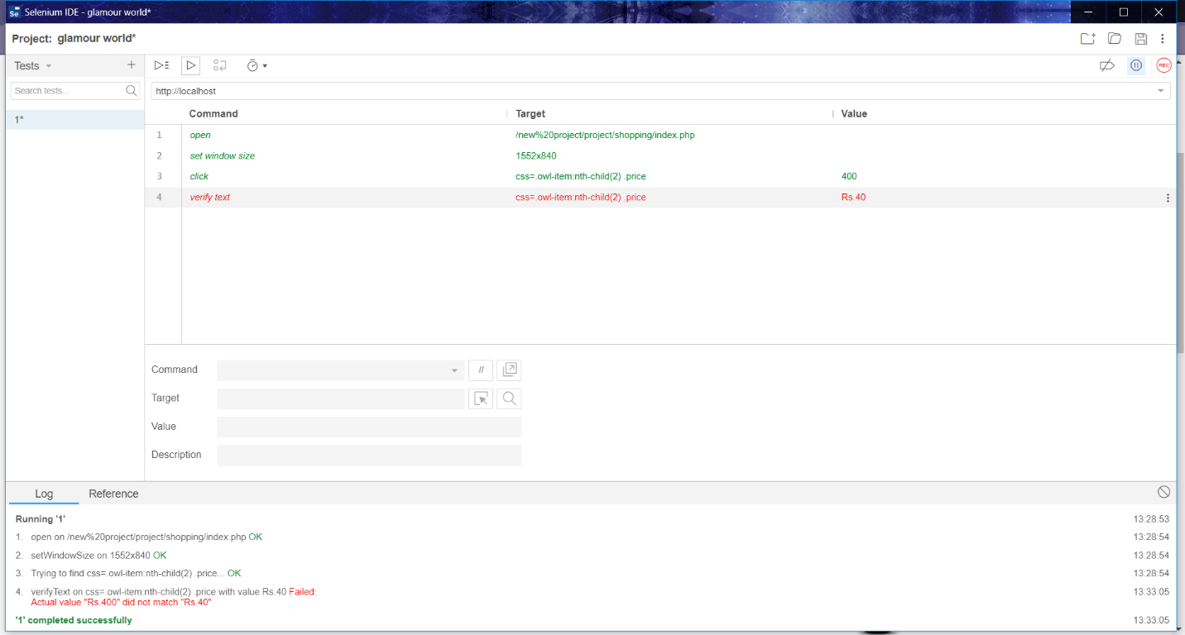

Slide 43
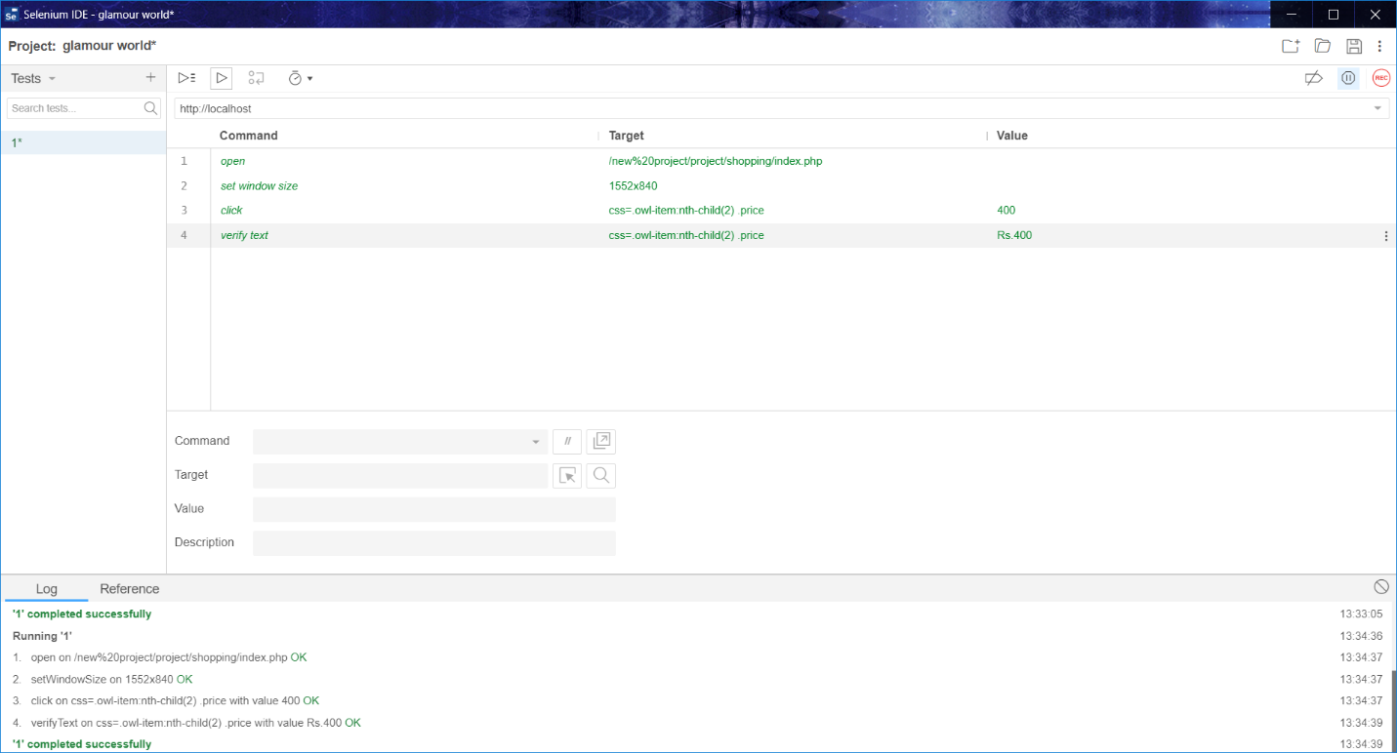

Slide 44
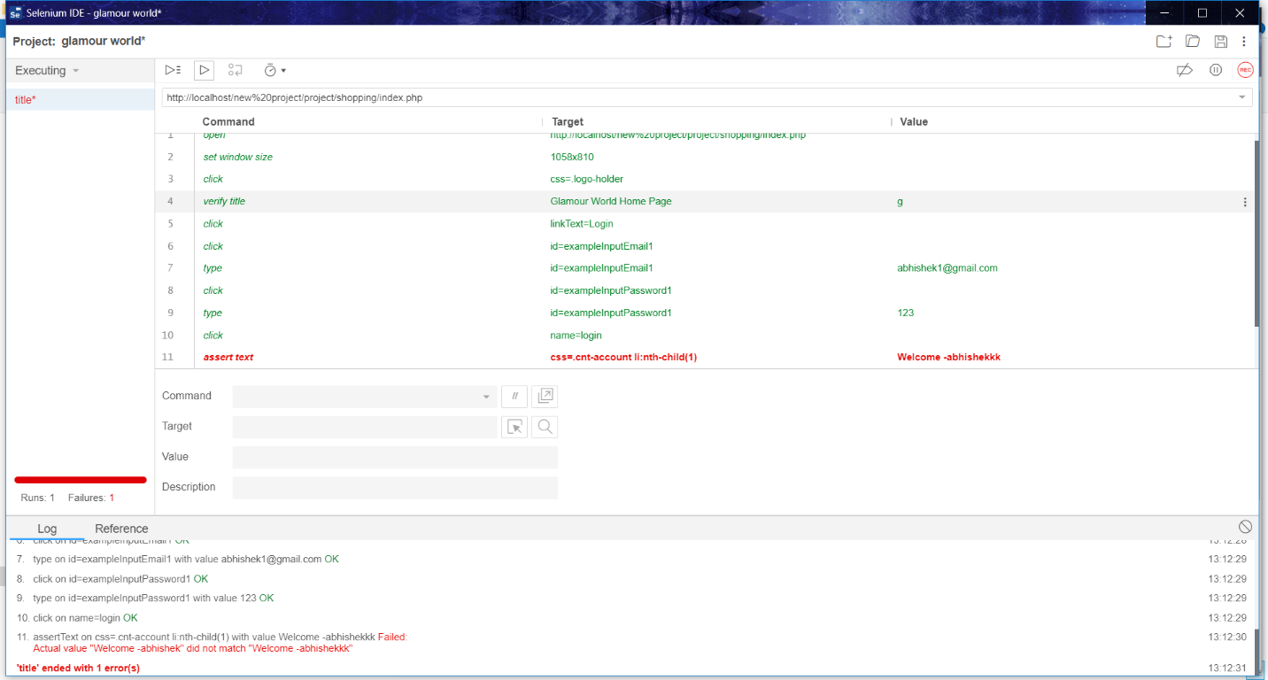

Slide 46

Thank You

